Slide 1



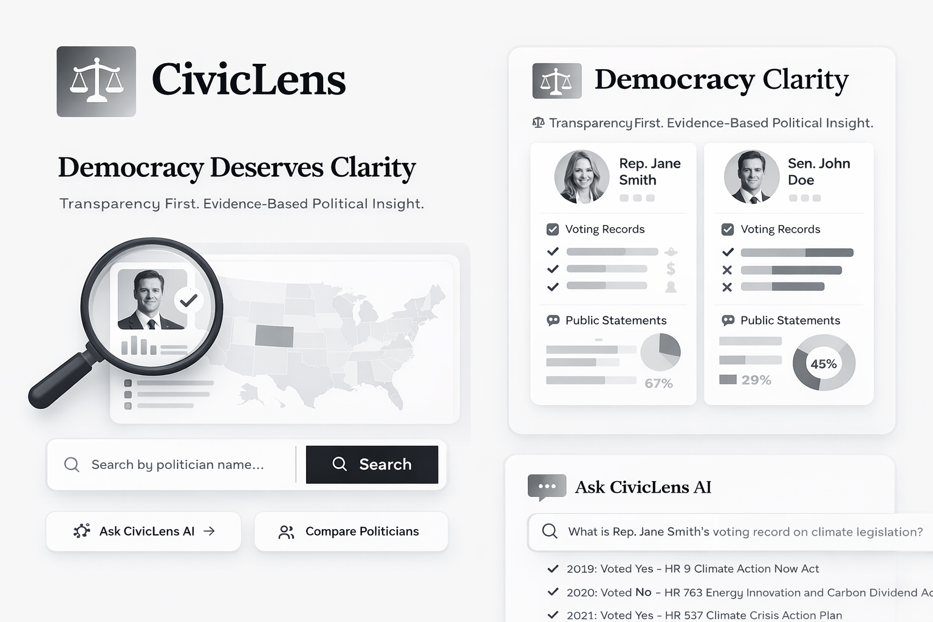



Olatomiwa Aluko
(Computer Engineering)
Schneidine Dorelien
(Computer Science)
Anthony Terry
(Computer Science)
Aridsondez Jerome
(Computer Science)

Slide 2

Problem
Solution
A non-partisan AI platform that transforms complex political data into clear, searchable insights.
Core Functionality: Users ask natural language questions like "Show me my district's candidates' stances on affordable housing"
The Platform Returns:
Comprehensive voting records with bill citations
Public statements from speeches and interviews with timestamps
Campaign finance data showing donor relationships
Automated contradiction detection flagging inconsistencies between promises and votes
Voters face three critical barriers when evaluating candidates:
Information Overload - Campaign promises, voting records, and funding sources are scattered across partisan outlets and inaccessible government databases
Hidden Contradictions - Politicians say one thing on the campaign trail but vote differently in office, with no accountability mechanism
Obscured Influence - Donor relationships and their connection to policy decisions remain invisible to average citizens

